Slide 1
GRAPH THEORY
Properties of Planar Graphs
Ch9-<number>

Slide 2
Properties of Planar Graphs
Definition:
A graph that can be drawn in the plane without any of its edges intersecting is called a planar graph. A graph that is so drawn in the plane is also said to be embedded (or imbedded) in the plane.
Applications:
(1) circuit layout problems
(2) Three house and three utilities problem
Ch9-<number>

Slide 3
Definition:
A planar graph G that is drawn in the plane
so that no two edges intersect (that is, G is embedded in the plane) is called a plane graph.
Fig 9-1
(a) planar,
not a plane graph
(c) another
plane graph
(b) a plane graph
Ch9-<number>

Slide 4
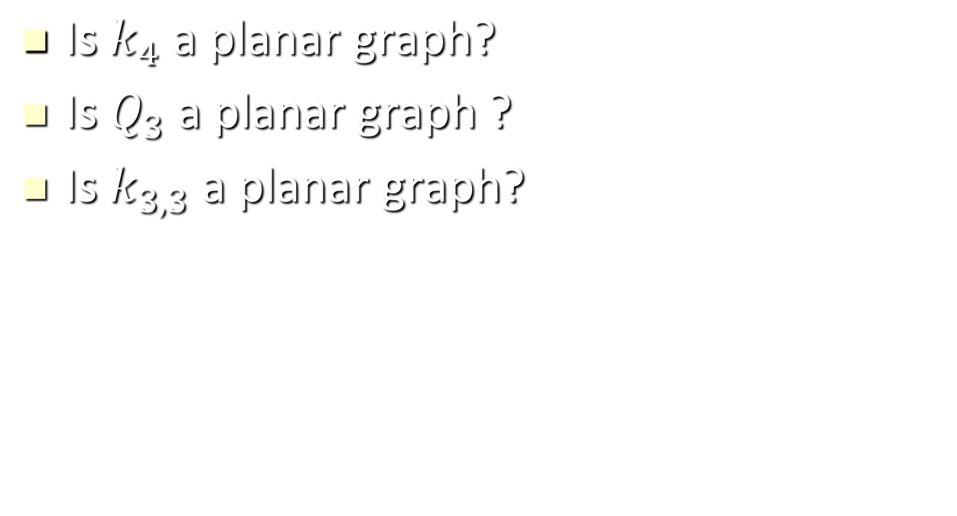
Example
Ch9-<number>

Slide 5
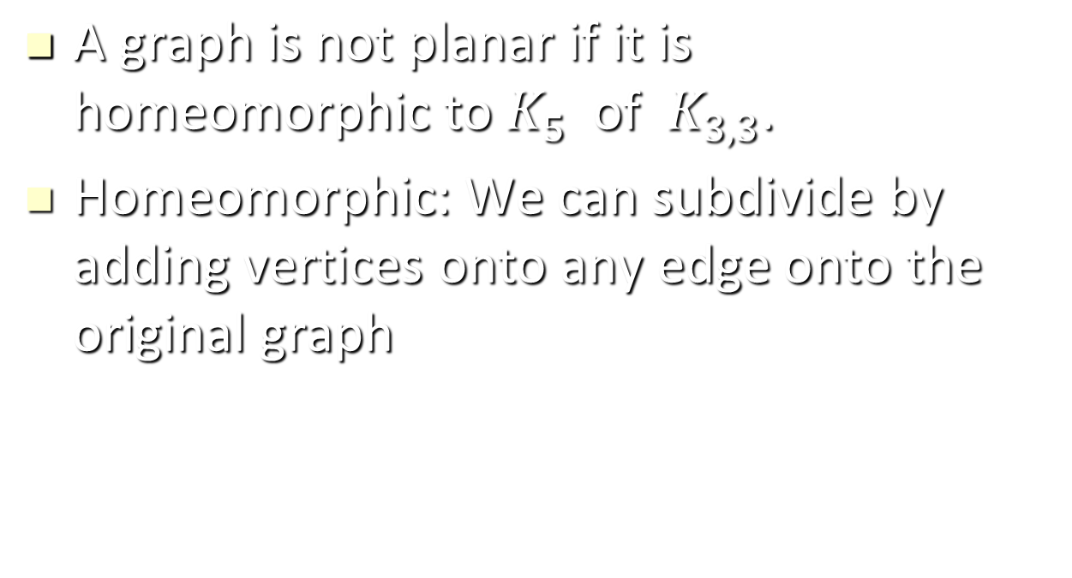
Kuratowaski’s Theorem
Ch9-<number>

Slide 6
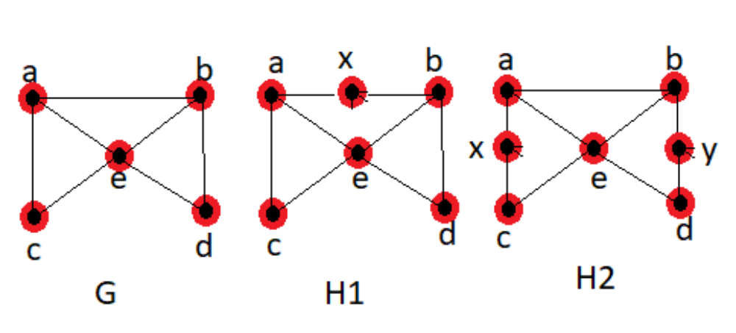
Example
G is homomorphic to H1 and H2, but H1 and H2 are not homomorphic
Ch9-<number>

Slide 7
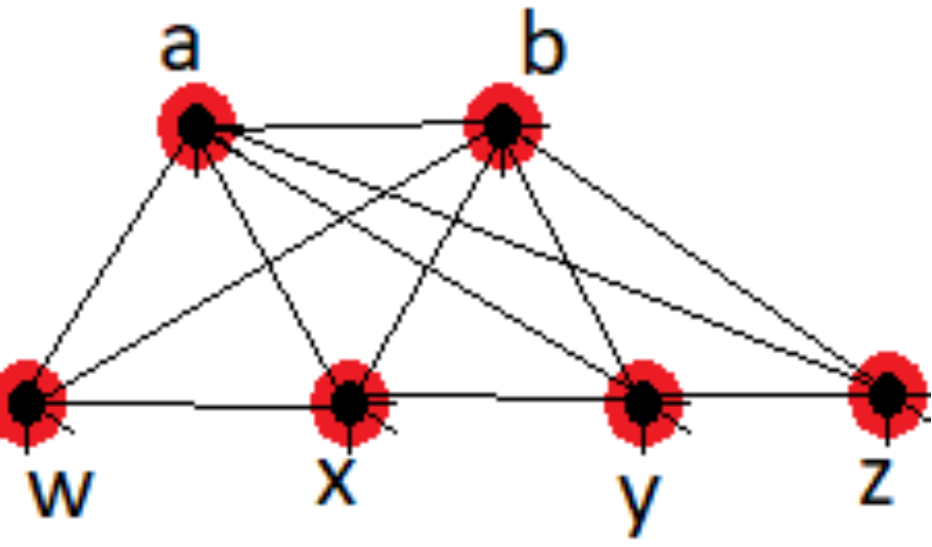
Example
Is the graph shown in figure planar?
Ch9-<number>

Slide 8
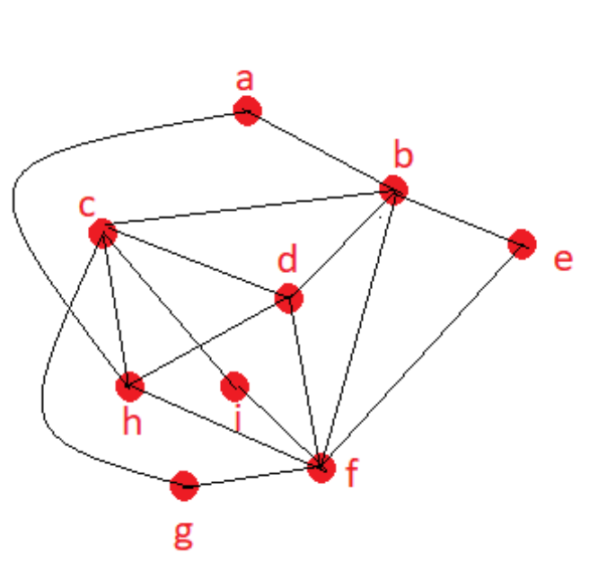
Example
Is the graph shown in figure planar?
Ch9-<number>

Slide 9
Note. A given planar graph can give rise to
several different plane graph.
Definition:
Let G be a plane graph. The connected pieces of the plane that remain when the vertices and edges of G are removed are called the regions of G.
Fig 9-2
G₁
R₃: exterior
R₁
R₂
G₁ has 3 regions.
Ch9-<number>

Slide 10
Definition:
Every plane graph has exactly one unbounded region, called the exterior region. The vertices and edges of G that are incident with a region R form a subgraph of G called the boundary of R.
Fig 9-2
G₂
G₂ has only 1 region.
Ch9-<number>

Slide 11
Fig 9-2
Boundary of R₁:
v₁
v₂
G₃
v₁
v₂
R₁
v₃
v₃
Boundary of R₅:
v₅
R₅
v₁
v₂
v₄
v₆
v₇
R₂
v₃
v₅
R₃
v₄
v₈
v₉
R₄
v₆
v₇
G₃ has 5 regions.
v₉
Ch9-<number>

Slide 12
Observe:
(1) Each cycle edge belongs to the boundary
of two regions.
(2) Each bridge is on the boundary of only one region.
(exterior)
Ch9-<number>

Slide 13
Thm 9.1: (Euler’s Formula)
If G is a connected plane graph with p vertices, q edges, and r regions, then
p − q + r = 2.
pf: (by induction on q)
(basis) If q = 0, then G ≅ K₁; so p = 1, r =1,
and p − q + r = 2.
(inductive) Assume the result is true for any
graph with q = k − 1 edges, where k ≥ 1.
Let G be a graph with k edges. Suppose G has
p vertices and r regions.
Ch9-<number>

Slide 14
If G is a tree, then G has p vertices, p−1 edges and 1 region.
⇒ p − q + r = p – (p−1) + 1 = 2.
If G is not a tree, then some edge e of G is on a cycle.
Hence G−e is a connected plane graph having
order p and size k−1, and r−1 regions.
⇒ p − (k−1) + (r−1) = 2 (by assumption)
⇒ p − k + r = 2
#
Ch9-<number>

Slide 15
Example
Suppose that a connected simple graph has 20 vertices. Each of degree 3. Into how many regions does a representation of this planar graph split the plane?
Ch9-<number>

Slide 16
Fig 9-4 Two embeddings of a planar graph
(a)
(b)
Ch9-<number>

Slide 17
Definition:
A plane graph G is called maximal planar if, for every pair u, v of nonadjacent vertices of G, the graph G+uv is nonplanar.
Thus, in any embedding of a maximal planar graph G
of order at least 3, the boundary of every region of G
is a triangle.
Ch9-<number>

Slide 18
Thm 9.2: If G is a maximal planar graph with v ≥ 3 vertices and e edges, then
e = 3v− 6.
pf:
Embed the graph G in the plane, resulting in
r regions.
⇒ v − e + r = 2.
Since the boundary of every region of G is a
triangle, every edge lies on the boundary of
two regions.
⇒
⇒ v− e+ 2e / 3 = 2.
⇒ e = 3v − 6
Ch9-<number>

Slide 19
Cor. 9.2(a): If G is a maximal planar bipartite graph with p ≥ 3 vertices and q edges, then q = 2p − 4.
pf:
The boundary of every region is a 4-cycle.
4r = 2q ⇒ p − q + q / 2 = 2 ⇒ q = 2p − 4.
Cor. 9.2(b): If G is a planar graph with p ≥ 3 vertices and q edges, then
q ≤ 3p − 6.
pf:
If G is not maximal planar, we can add edges
to G to produce a maximal planar graph.
By Thm. 9.2
Ch9-<number>

Slide 20
Thm 9.3: Every planar graph contains a vertex of degree 5 or less.
pf:
Let G be a planar graph of p vertices and
q edges.
If deg(v) ≥ 6 for every v∈V(G)
⇒
⇒
2q ≥ 6p →←
Ch9-<number>

Slide 21
Fig 9-5 Two important nonplanar graph
K_{3,3}
K₅
Ch9-<number>

Slide 22
Thm 9.4: The graphs K₅ and K_{3,3} are nonplanar.
pf:
(1) K₅ has p = 5 vertices and q = 10 edges.
q > 3p − 6 ⇒ K₅ is nonplanar.
(2) Suppose K_{3,3} is planar, and consider any
embedding of K_{3,3} in the plane.
Suppose the embedding has r regions.
p − q + r = 2 ⇒ r = 5
K_{3,3} is bipartite
⇒ The boundary of every region has ≥4 edges.
⇒
→←
Ch9-<number>

Slide 23
Definition:
A subdivision of a graph G is a graph obtained by inserting vertices (of degree 2) into the edges of G.
Ch9-<number>

Slide 24
Fig 9-6 Subdivisions of graphs.
H
G
H is a subdivision of G.
F
F is not a subdivision of G.
Ch9-<number>

Slide 25
Thm 9.5: (Kuratowski’s Theorem)
A graph is planar if and only if it contains no subgraph that is isomorphic to or is a subdivision of K₅ or K_{3,3}.
Fig 9-7 The Petersen graph is nonplanar.
1
2
3
1
4
5
6
10
7
4
5
6
2
3
8
9
(a) Petersen
(b) Subdivision of K_{3,3}
Ch9-<number>

